Slide 1
The Mouse and the Motorcycle Chapter 3

Slide 2
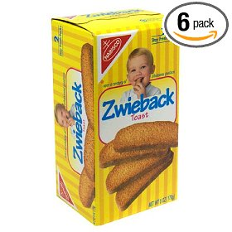
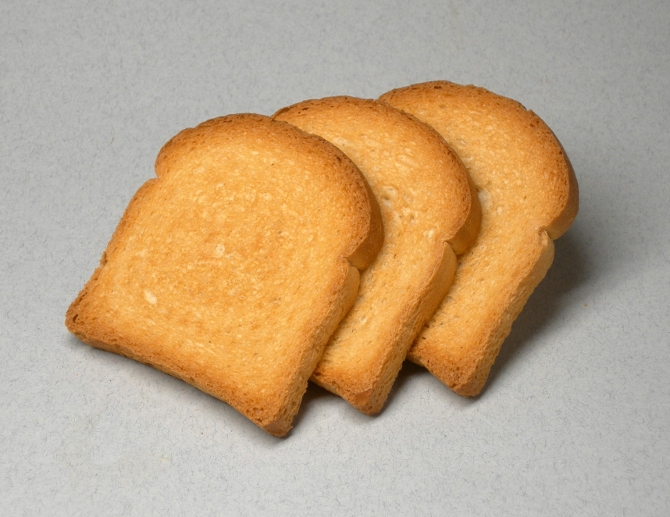
Zwieback
Zwieback are crackers that look like little pieces of hard toast. Nabisco doesn’t make them anymore, but other cracker brands do. It can also be called Melba toast at the store. Your clue word is toast.

Slide 3
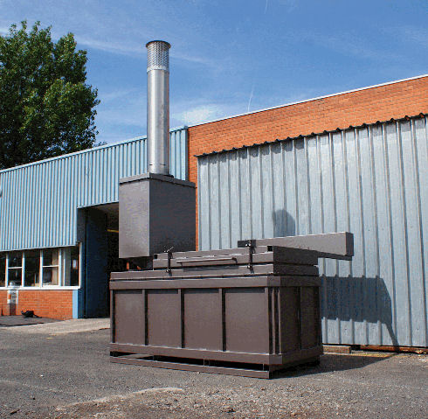
incinerator
This is called an incinerator that was used to burn trash. Almost every elementary school had one. My elementary school did. Hotels and stores had incinerators as well. They are not used anymore because people discovered that they were causing pollution! Now we recycle our paper. Your clue word is recycle.

Slide 4
More Chapter 3 Words & Questions
Battered means kind of beat up.
Nearsighted means that you can only see things that are near to you. Things that are far away are blurry.
Remorseful (remorse) means that you feel bad about something that you have done.
A tourist is someone who is on vacation.
Seized means grabbed.
A predicament is a hard situation or a problem.
Find where this chapter tells about Ralph feeling embarrassed. Write it down on the “Getting to Know Ralph” page.
Can you find a simile in this chapter? In the simile, there is a three-letter word that starts with the letter g. That is your clue word!

