Slide 1
The Mouse and the Motorcycle Chapter 9 Ralph Takes Command

Slide 2
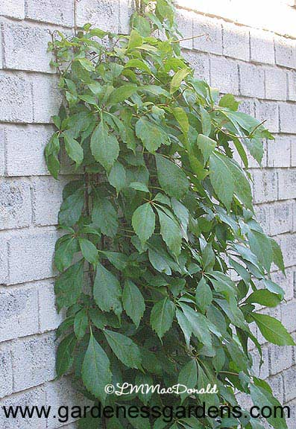
Virginia creeper

Slide 3
envied (envy) – want to be like someone
flattered (flatter)– to feel complimented or praised
reminisced (reminisce) – think about what happened in the past
conceded (concede) – agreed
entitled – allowed to have
pandemonium – mess, craziness
agitated – worried, nervous
powwow – important meeting

Slide 4
ventured – asked about
foolhardy – careless, foolish
ominously – threatening or warning about the future
exterminator – someone who sprays chemicals to kill bugs and rodents
flee – leave quickly
bewildered – confused
scrabbling – scratch or scrape and wander around

Slide 5
2020 Class – You don’t need to write these down. Just think about them.
Please answer these questions in a complete sentence.
Why is this chapter called “Ralph Takes Command”? This chapter is called “Ralph Takes Command” because……..
What has Ralph managed to do that no one else in the history of their family has been able to do? Ralph has managed to…………
At the very end of the chapter, Ralph’s mother is still worried about something. What is Ralph’s mother worried about? How could that worry be solved?
Ralph’s mother is worried that…….
One way the worry could be solved would be……………..

Slide 6
2020 Class – You do need to do this. The hamburger model is in your packet. Hamburger Question: In what ways could Ralph’s family show their gratitude to Keith for room service?
Top Bun (Introduction) – I think that Ralph’s family could thank Keith for room service in several ways.
Meat (Reasons) -
First, Next, Finally,
Bottom Bun (Conclusion) - These are several ways that Ralph’s family could thank Keith for room service.

