Slide 1
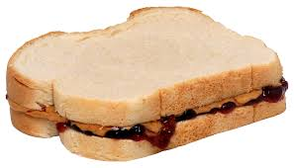
The Mouse and the Motorcycle Chapter 6

Slide 2
nuisance – getting on your nerves, annoying
astounded – surprised or amazed
incredulous – not sure about something
stoutly – large and heavy or not giving in
seized - grabbed
boast – brag
chasten – punish
generous – having plenty or a very giving person
implored – begged
Your clue word is one of the words on this page and it rhymes with toast!

Slide 3
Writing Task – Chapters 5 & 6 Look in your packet for more directions on this. This is just your sentence starter.
When the wall was pulled down, I saw many different things! First, (list what household object you saw and what the mice were using it for)
Next,
Last,
Clue word: wall

