Slide 1
The Mouse and the Motorcycle Chapter 5

Slide 2
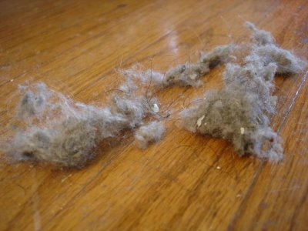
dust mice or dust bunnies

Slide 3
Vocabulary
jauntily - bouncy
hesitated - paused
exhilarated – happy and free
tousled - messy
captive – prisoner, not free
arouse - stir up or excite

Slide 4
cockiness - overly self-confident
timid - shy
astonished - surprised
reluctantly – don’t want to do something
threshold – something is about to happen

Slide 5
2020 Class: You don’t need to do this.
Hamburger Paragraph Question: Why do you think Matt, the bellboy, doesn’t get upset about the mice in the hotel?
Topic Sentence (top bun) - I think that Matt doesn’t
get upset about mice in the hotel for several reasons.
First, Next, Last or Finally
Closing Sentence (bottom bun) – These are the reasons
why I think Matt doesn’t get upset about mice in the hotel.

