Slide 1
The Mouse and the Motorcycle
Chapter 1

Slide 2
bellboy

Slide 3
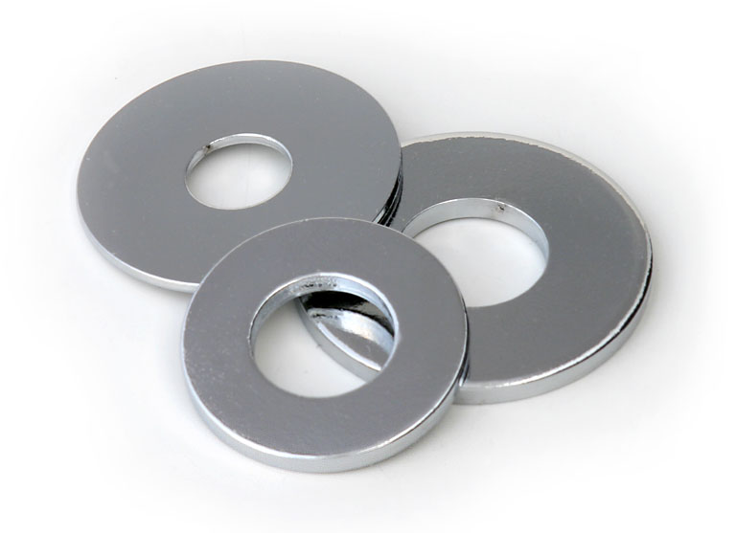
washers

Slide 4
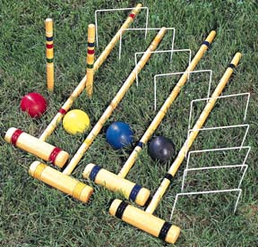
croquet

Slide 5
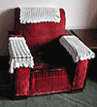
antimacassar

Slide 6
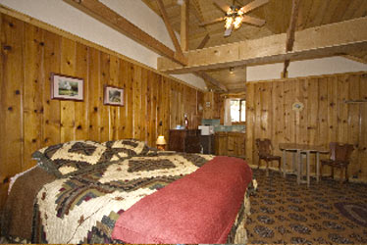
knotty pine walls

Slide 7
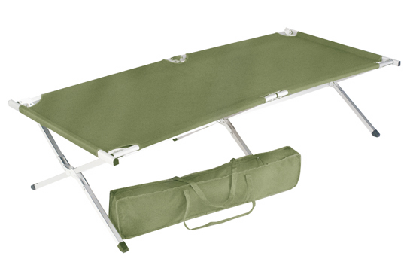
cot

Slide 8
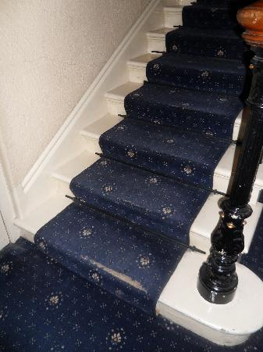
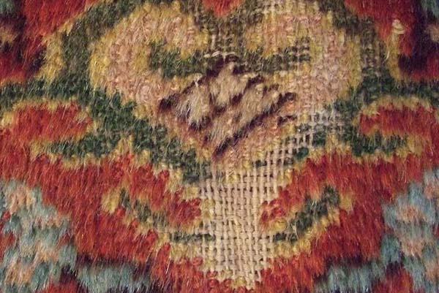
threadbare

Slide 9
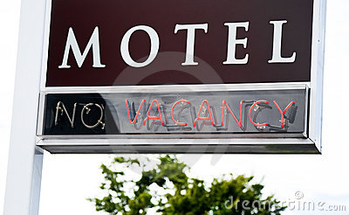
vacancy

Slide 10
Hotel + Motor = Motel

Slide 11
Hotel

Slide 12
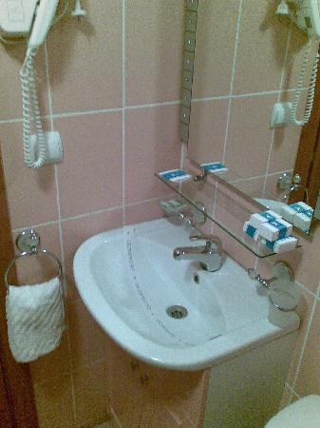
washbasin

Slide 13
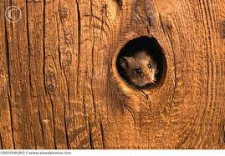
knothole

Slide 14
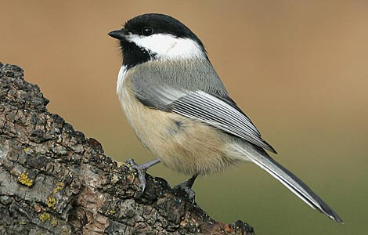
chickadee

Slide 15
The Mouse and the Motorcycle
Chapter 2

Slide 16
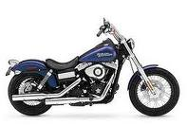
chromium muffler

Slide 17
jauntily – easy and bouncy momentum – speed

